Slide 1
Project Title
Visualizing Housing Market Trends:
An Analysis of Sale Prices and Features using Tableau
Team ID : LTVIP2025TMID60544
Team Size : 3
Team Leader : Annamdevula Hema Venkata Sri
Team member : Dola Gowthami
Team member : Chillara Venkata Ramakrishna

Slide 2
Objective
To analyze housing data and visualize trends such as house prices, age, and renovation impact using Tableau, enabling data-driven decision-making for stakeholders like real estate analysts and executives.
Dataset Used
Source: kc_house_data.csv
Size: ~21,000 records
Attributes: Includes price, bedrooms, bathrooms, floors, condition, renovation year, square footage, and more.

Slide 3
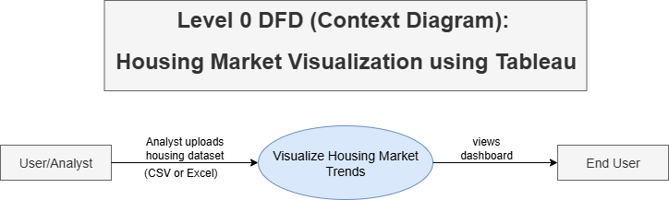
Data Flow Diagrams
DFD Level 0:
DFD Level 0 shows a high-level overview of the system where the User uploads housing data, the system processes it, and the End User views the visualized dashboard output.

Slide 4
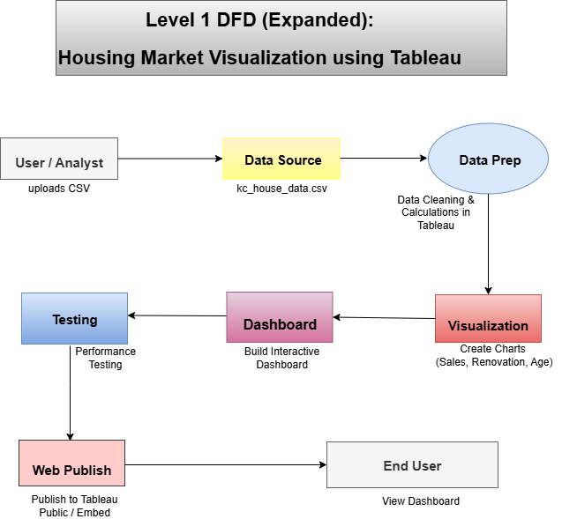
DFD Level 1:
DFD Level 1 details the step-by-step flow from data upload to cleaning, visualization, dashboard creation, testing, and publishing for end-user access.

Slide 5
Data Preparation
Cleaned the dataset by removing null values and duplicates
Standardized column formats (e.g., dates, numerical fields)
Created calculated fields like: ▸ House Age = 2025 - yr_built ▸ Years Since Renovation = 2025 - yr_renovated
Renamed confusing or inconsistent column names for clarity
Filtered irrelevant records (e.g., zero bedroom/floor houses)
Ensured data is structured and ready for meaningful visualization in Tableau

Slide 6
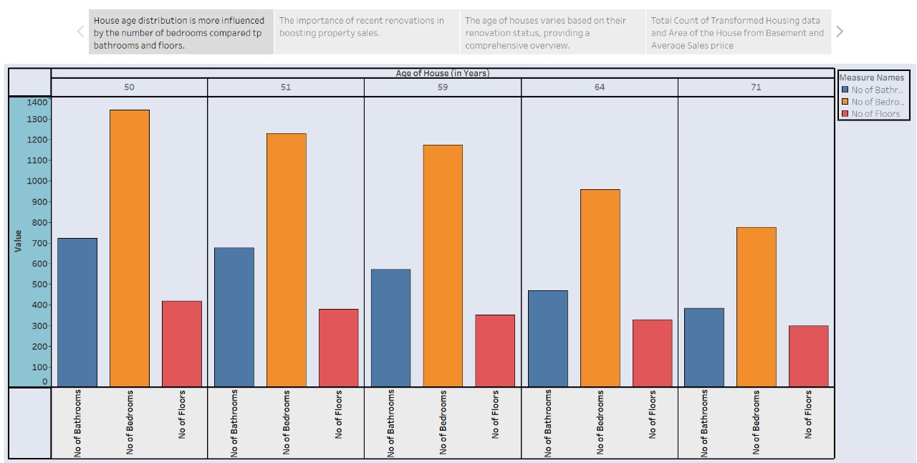
Visualizations
House Age vs Features
Displays how house age correlates with the number of bathrooms, bedrooms, and floors—highlighting which features influence housing age the most.

Slide 7
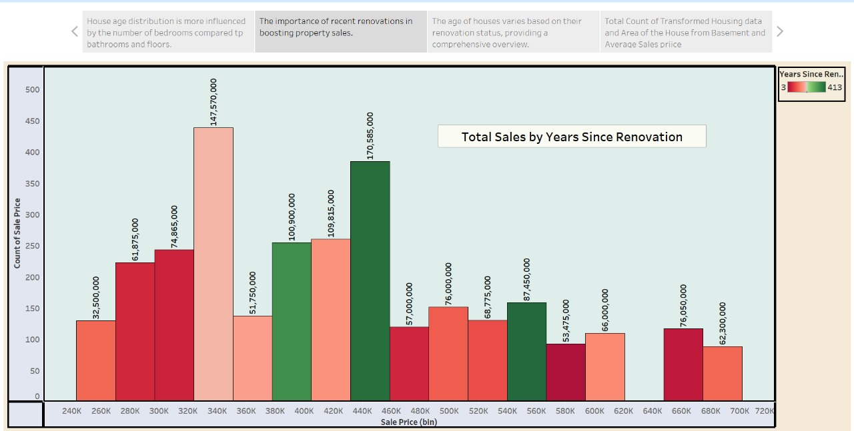
Total Sales by Years Since Renovation
Bar chart shows how recent renovations impact house sale prices—newly renovated homes have higher sales counts in specific price bins.

Slide 8
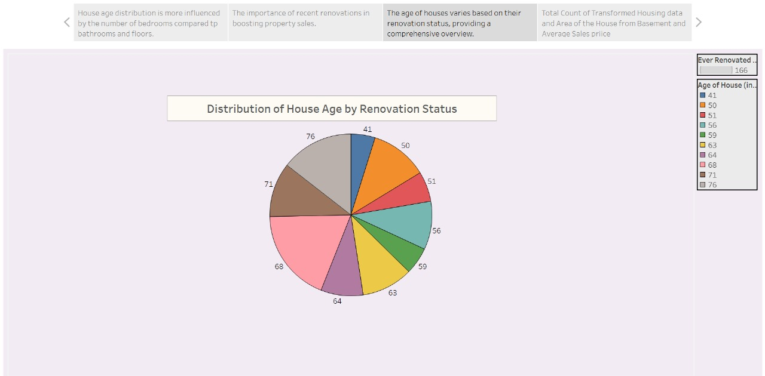
Distribution of House Age by Renovation Status
Pie chart illustrates the spread of house age grouped by whether they’ve been renovated, helping identify market trends across age categories.

Slide 9
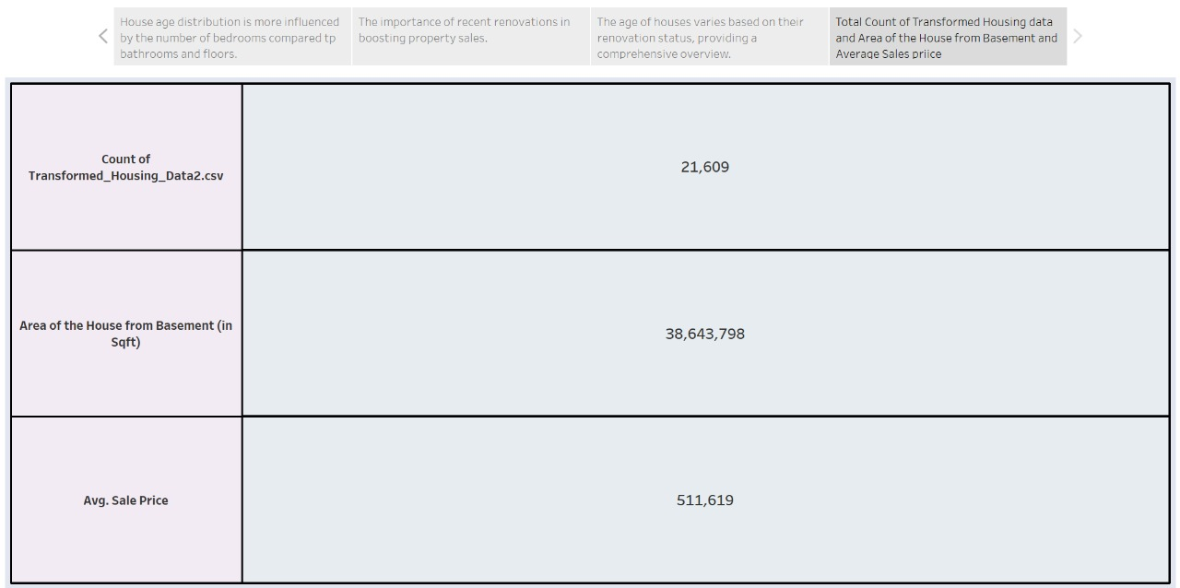
Overall Dataset Summary Summary metrics include:
Total data points analyzed: 21,609
Basement Area (sqft): 38,64,798
Average Sale Price: ₹511,619

Slide 10
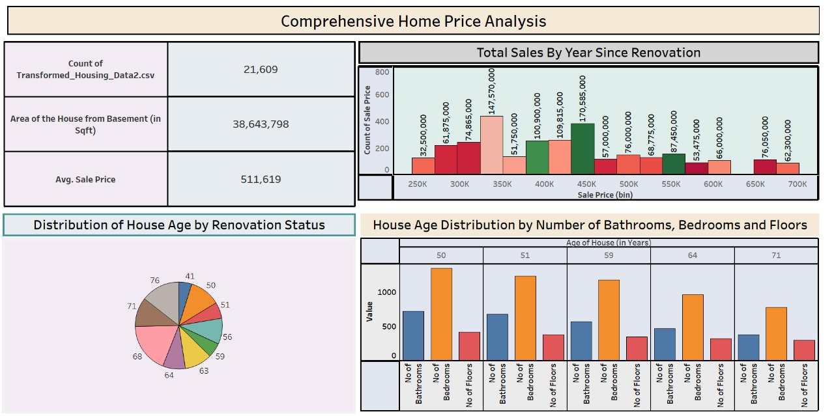
Dashboard

Slide 11
Publishing
After creating the dashboard, it is published on Tableau Public for wider access.
This step explains how users can view, share, or embed the dashboard online.
📌 Steps:
Publish to Tableau Public
Generate shareable link
Export charts as images or PDFs (if needed)

Slide 12
Advantages
Interactive Dashboards: Users can filter by house age, renovation, and price for personalized insights.
Simplified Analysis: Visuals make complex housing data easy to understand.
Supports Decisions: Helps real estate teams make pricing and marketing decisions.
Web-Friendly: Dashboards can be published or embedded online.
Scalable Design: Can be extended with new data or integrated with future tools.

Slide 13
Disadvantages
Static Data Risk: Insights depend on updated CSV uploads.
Limited Prediction Support: Tableau is not ideal for advanced ML or forecasting.
Initial Learning Curve: Non-technical users may need guidance.
Performance Issues: Very large datasets may slow performance.

Slide 14
Conclusion
This project provides a comprehensive view of housing market trends through interactive Tableau dashboards.
It simplifies raw housing data into insightful visuals for real estate decision-making.
Stakeholders can explore trends by sale price, renovation year, house age, and more.
The project enhances data-driven strategies for marketing, pricing, and customer targeting.
With web integration and future expansion possibilities, this solution is both scalable and impactful.

Slide 15

“Data is a precious thing and will last longer than the systems themselves.”
— Tim Berners-Lee

